Slide 1





Slide 2
Grandparent
v1.0
Parent
Child

Slide 3
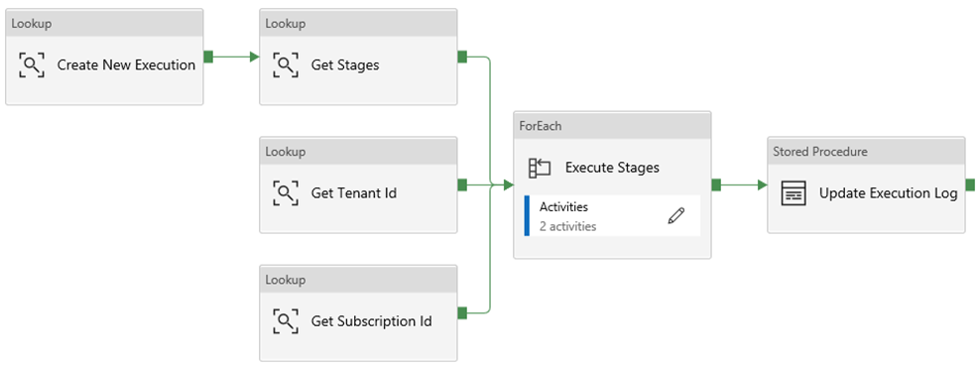
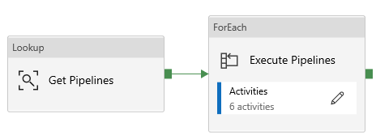
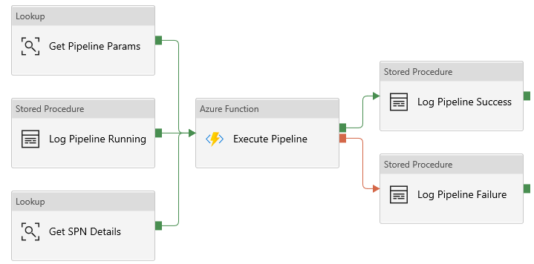
Grandparent
v1.1
Parent
Child

